Slide 1
Optical communications and data networks (EENGM2001) Week15_Lecture017_ASync_DispersionManagement
Siddarth K Joshi

Slide 2
Optical diesperson compensation: General Principles
As the transmission link length is increased by optical amplification, dispersion accumulates.
For single channel transmission, fibres with opposite dispersion can be used in each span to achieve zero accumulated dispersion
For WDM transmission, dispersion of channels in the centre as well as at edges of the band needs to be compensated to acceptable levels
Dispersion slope is therefore important

Slide 3
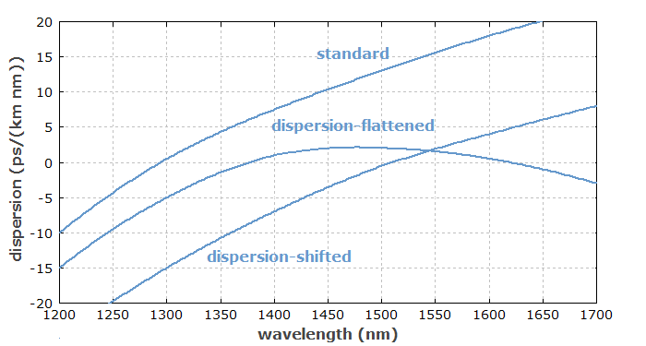
Dispersion compensating fibre (DCF)

Slide 4
Dispersion Map & dispersion compensation for single channel using different types of fibre
SMF
L
Dispersion profile (ps/nm-km)
DCF
Accumulated Dispersion (ps/nm)
In systems it is the total accumulated dispersion DxL that decides the pulse broadening.
DCF can provide up to -1360 ps/nm compensation, sufficient for SMF span of 80km
However DCF has high loss (9 dB for -1360ps/nm)
When NZ-DSF with negative dispersion (about -3 ps/nm-km) is used, SMF can be used to compensate its dispersion. The span would consist of about 28% of SMF (17ps/nm-km) and 72% of negative dispersion NZ-DSF (-3 ps/nm-km).
This is used for submarine systems but not for terrestrial systems

Slide 5
NZ-DSF
Dispersion D of Positive and negative NZ-DSFs
1500 nm
1550 nm
1600 nm
When negative NZ-DSF is used as transmission fibre, its dispersion may be compensated by using SMF

Slide 6
Dispersion slope compensation
If the total optical bandwidth of the WDM signal is Λ, transmission fibre has a dispersion of D at centre of band and dispersion slope of D’ (ps/nm²-km), then after span length L the dispersion difference between the lowest and highest wavelength is ΛD’L (ps/nm).
ΛD’L
L
l
Dispersion map for WDM channels compensated by a constant negative dispersion

Slide 7
Intro
If a fibre with opposite dispersion is used to compensate the dispersion for the central channel, we have
where D_{T} and D_{C} are the dispersion of transmission and compensation fibres. The dispersion at edges of the wavelength band accumulated after the span compensation is
In order for this to be zero, it is required that the relative dispersion slopes (RDS) of both fibres
match each other. Otherwise there will be a walk-off in accumulated dispersion.

Slide 8
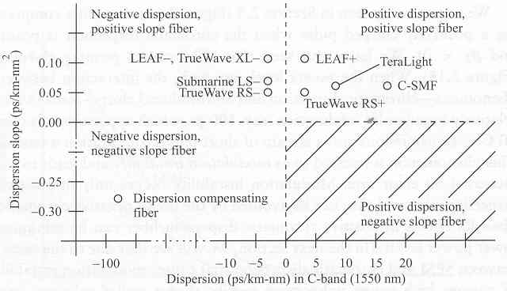
…But it is not always possible to have RDS matching. This is particularly problematic for submarine systems as they use negative dispersion fibres in the upper left quadrant, but no fibre is available in the lower right quadrant.

Slide 9
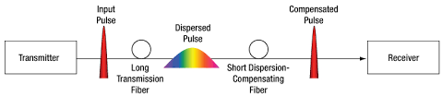
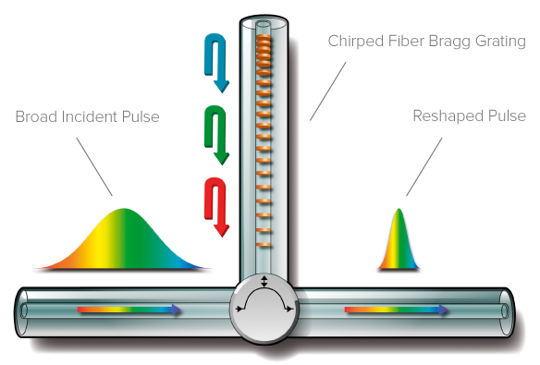
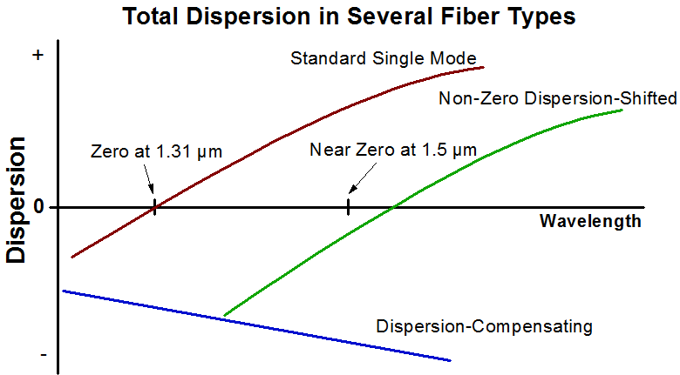

Slide 10
Nonlinearity and 50/50 Compensation
Nonlinear effects (XPM, FWM) are severe when accumulated dispersion is small due to channels being synchronous with each other over longer distances.
It is therefore useful to have large local dispersion, but small total dispersion.
This can be done by allow dispersion to accumulate for half of the link length, over compensate it in the middle, then allow it to reach zero by end of link length.

Slide 11
Dispersion compensation using chirped fibre grating
Chirped fibre grating
input
Reflected wavelength
=
2x grating period
delay
output
frequency
Chirped fibre grating can be engineered to give any desirable dispersion performance.
The dispersion-bandwidth product (which = the total delay) is fixed for a fixed length grating (~ 10 ns / m).
So in order to compensate large dispersion over wide bandwidth, long CFGs are needed.

Slide 12
Electronic Dispersion Compensation (EDC)
‘FIR response’
v_{g}^{(m)} is the group velocity of mode m.
When this model is applied to single mode fibre, vg is a continuous function of frequency or wavelength. The sum becomes an integration over the spectral range of the signal.
Fourier transform of such impulse response will give a low pass filter characeristics. Therefore fibre group delay dispersion limits the bandwidth of the fibre.

Slide 13
EDC
receiver response
detected optical signal spectrum
Poor SNR
output signal spectrum
Noise floor
f
The effect of dispersion can be compensated by making a filter in the receiver.
Continuous time filters (CTF):
Lift the high frequency response of the Transimpedance amplifier to give an overall broader bandwidth to the system.
But this can be limited by SNR if the system has noise (e.g., EDFA)

Slide 14
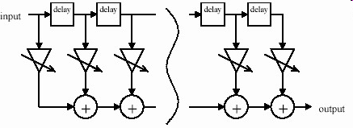
EDC
Digital transversal filters

Slide 15
EDC
The transversal filter can be seen as doing the opposite of the dispersion:
it returns the dispersed impulse reponse back into a single output impulse.
This can be done by adjusting the delay and weight of each arm of the transversal filter
Works for a fixed dispersion
But needs to be adaptive

Slide 16
EDC
Feed-forward equalizer (FFE) and /or decision feedback equalizer (DFE):
FFE focuses more on removing distortion prior to a symbol’s main energy point (also called the pre-cursor area)
DFE compensates for the interference following a symbol’s main energy point (also called the post-cursor area)
FFE
DFE

Slide 17
EDC implementation
Self-adaptive:
An EDC chip has to be able to adapt to a range of dipsersion characteristics
e.g: For SMF and MMF, dispersion characteristics very different
Standardisation:
SMF long reach systems
MMF/SMF10GbE systems

Slide 18
Dispersion: effects and how to deal with it
Dispersion causes pulse spreading
Reduction in the pulse amplitude
Reduction in SNR due to ISI
Dispersion causes a receiver sensitivity power pensalty
Acceptable levels between 1 to 3 dB
This PP needs to be included in system power budget
Different acceptable levels of PP limit the transmission distance

Slide 19
Dispersion limited transmission distance
Signal spectral width:
when it decided by the light source spectral width ( hence independent of data rate): BDLΔλ is constant.
When using narrow spectral source+external modulation: B²DL is constant.
Data pulse format
RZ or NRZ have different levels of tolerance to dispersion
RZ more tolerant

Slide 20
Dispersion compensation
Optical compensation
Using fibres with opposite D
SMF+DCF
NZ-DSF (with –D) + SMF
Dispersion map
Diespersion slope compensation: relative dispersion slope (RDS) matching
Using chirped fibre grating
Electronic Dispersion compensation (EDC)

